Slide 1
Vasari Talk – How accurate is Vasari?
Wednesday 11th October 2012

Slide 2
Outline of discussion topics…
Energy analysis (20-25 min):
  The purpose of Vasari / Conceptual Energy Analysis
  Main drivers of energy use/cost (and analysis) of buildings
  Computational accuracy Vs. Information accuracy
  DOE2 simulation engine strengths and weaknesses
  Key things to watch out for
Solar analysis (5-10 min):
  Outline of the computational method
Wind analysis (5-10 min):
  Computational Fluid Dynamics
  2D & 3D / Meshing / Turbulence
  Validation
Q&A (15-30 min)

Slide 3
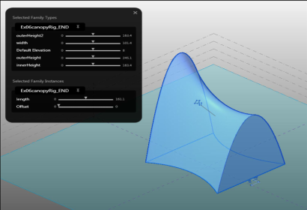
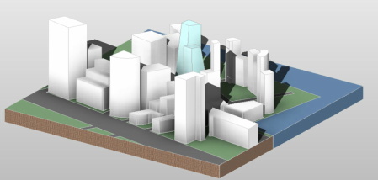
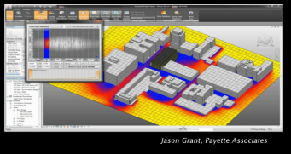
Energy analysis…
The purpose of Vasari / Conceptual Energy Analysis:
  BIM based (parametric) conceptual modeling
  Application to early design stage e.g. master planning, concept
  Rapid model development and feedback on performance
  Building form and envelope ‘optimization’
  ‘Directionally accurate’ analysis

Slide 4
Energy analysis...
Main drivers of energy use / cost (and analysis) of buildings:
Driver | Design / Operational | Components | Vasari Information / Assumptions
Climate | Operational | Air temperature Relative humidity Direct & Diffuse solar radiation Wind speed & direction | Typical Meteorological Years (TMYs) 1.2 million+ worldwide (2004 & 2006) Exact location and period specific (GBS)
Form / Layout | Design | Orientation Massing Percentage glazing Exterior shading | Conceptual masses with auto-zoning
Materials | Design | Layer Density, Specific Heat Capacity and Conductivity Element Absorptance, Roughness Glazing U-value, SHGC, VLT | Conceptual constructions (broad brush - typical, high or low performance options)
Systems | Design | Lighting, Equipment Primary heating and cooling Secondary distribution Controls | ASHRAE building / space type data (fixed) ASHRAE baseline system types (‘generally’ / fixed)
Use | Operational | Occupancy Hours of operation Set-points | ASHRAE building / space type data (fixed)
Tariffs | Operational | $ / kWh electricity $ / kWh fuel | State wide flat rate averages
Reliable / Consistent
Goal of Vasari / CEA
Set by building / space type
Reasonable assumptions

Slide 5
Energy Analysis…
Computational accuracy Vs. Information accuracy:
Main Computational
Components:
Main Information
Components:
Driver | Components
Climate | Air temperature Relative humidity Direct & Diffuse solar radiation Wind speed & direction
Form / Layout | Orientation Massing Percentage glazing Exterior shading
Materials | Layer Density, Specific Heat Capacity and Conductivity Element Absorptance, Roughness Glazing U-value, SHGC, VLT
Systems | Lighting, Equipment Primary heating and cooling Secondary distribution Controls
Use | Occupancy Hours of operation Set-points
Tariffs | $ / kWh electricity $ / kWh fuel
External and internal heat losses and gains via conduction, convection & radiation
+
HVAC system efficiency
Well understood and proven…
Information, understanding and time are by far the weakest links…

Slide 6
Energy analysis…
DOE2 simulation engine strengths and weaknesses:
  Whole building dynamic thermal energy simulation
  Well understood and proven
  Very fast
  Hourly time steps
  Decoupled building and HVAC system simulation
  Some simplification of building thermal mass
  Some simplification of solar radiation transfer
  Limited inter-zonal air exchange (‘bulk’ airflow simulation)
  Advanced HVAC systems e.g. displacement ventilation, radiant heating/cooling etc.

Slide 7
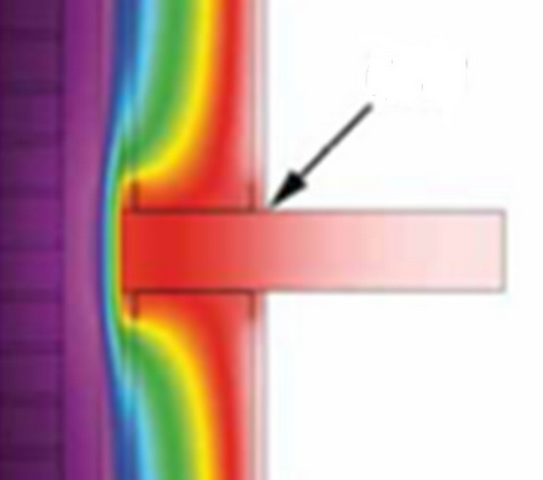
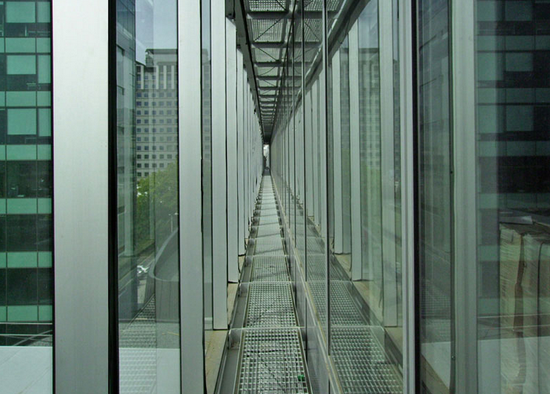
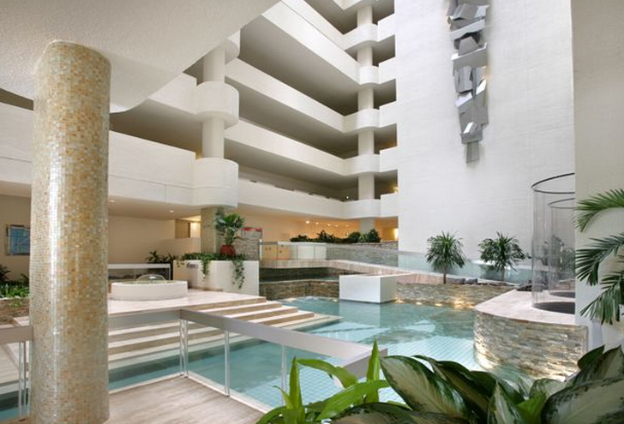
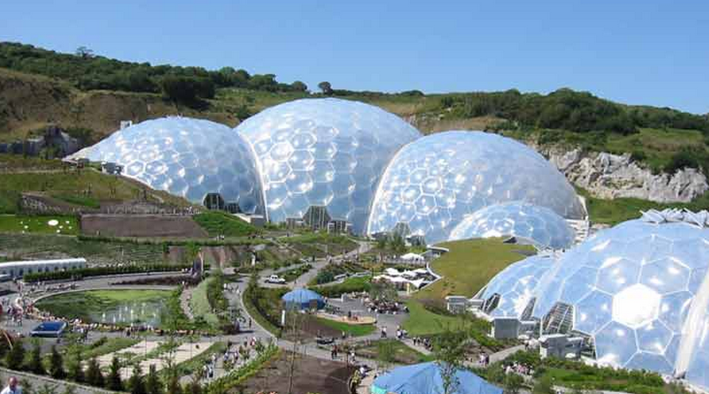
Energy analysis…
Key things to watch out for:
  Large open spaces
  Highly glazed areas
  Advanced materials e.g. transparent insulation
  Advanced systems e.g. displacement ventilation, radiant h/c
  Passive solar features e.g. natural ventilation
  Building type detail e.g. an office vs a house
  Thermal bridging
‘Thermally complex’ like atria, double skin facades

Slide 8
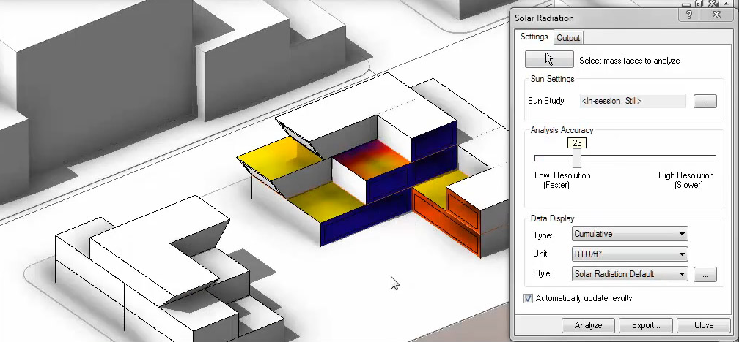
Solar analysis…
Outline of the computational method
  Conceptual masses / surfaces
  Latitude, Longitude and Site Elevation
  Solar Azimuth & Altitude
  Direct and Diffuse solar radiation:
    Hourly values from climate data (can be downloaded from GBS)
    Different climate data yields different results
  Validation

Slide 9
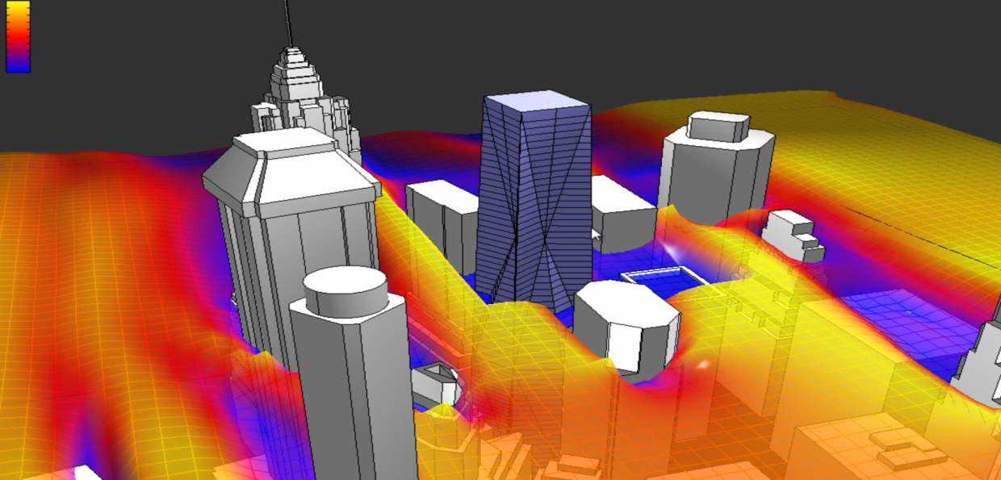
Wind analysis
Computational Fluid Dynamics
Derived from Autodesk Moldflow (aka Falcon) and includes:
  Automatic voxel based meshing
  2D & 3D Navier Stokes
  Incompressible fluid / Finite volume
  Large Eddy Simulation (LES) Smagorinksy Turbulence model
  Transient i.e. simulates change over time
Climate data driven to help understand local wind effects
Validation
Very
fast!

Slide 10
Q&A…

